Slide 1

Dynamite
Recipes
Damien Luzzo, Christopher Kennard, Chamo , Vincent Sullivan, Stephanie Cortez Help from: Leah , Megan, Christian and Google!

Slide 2
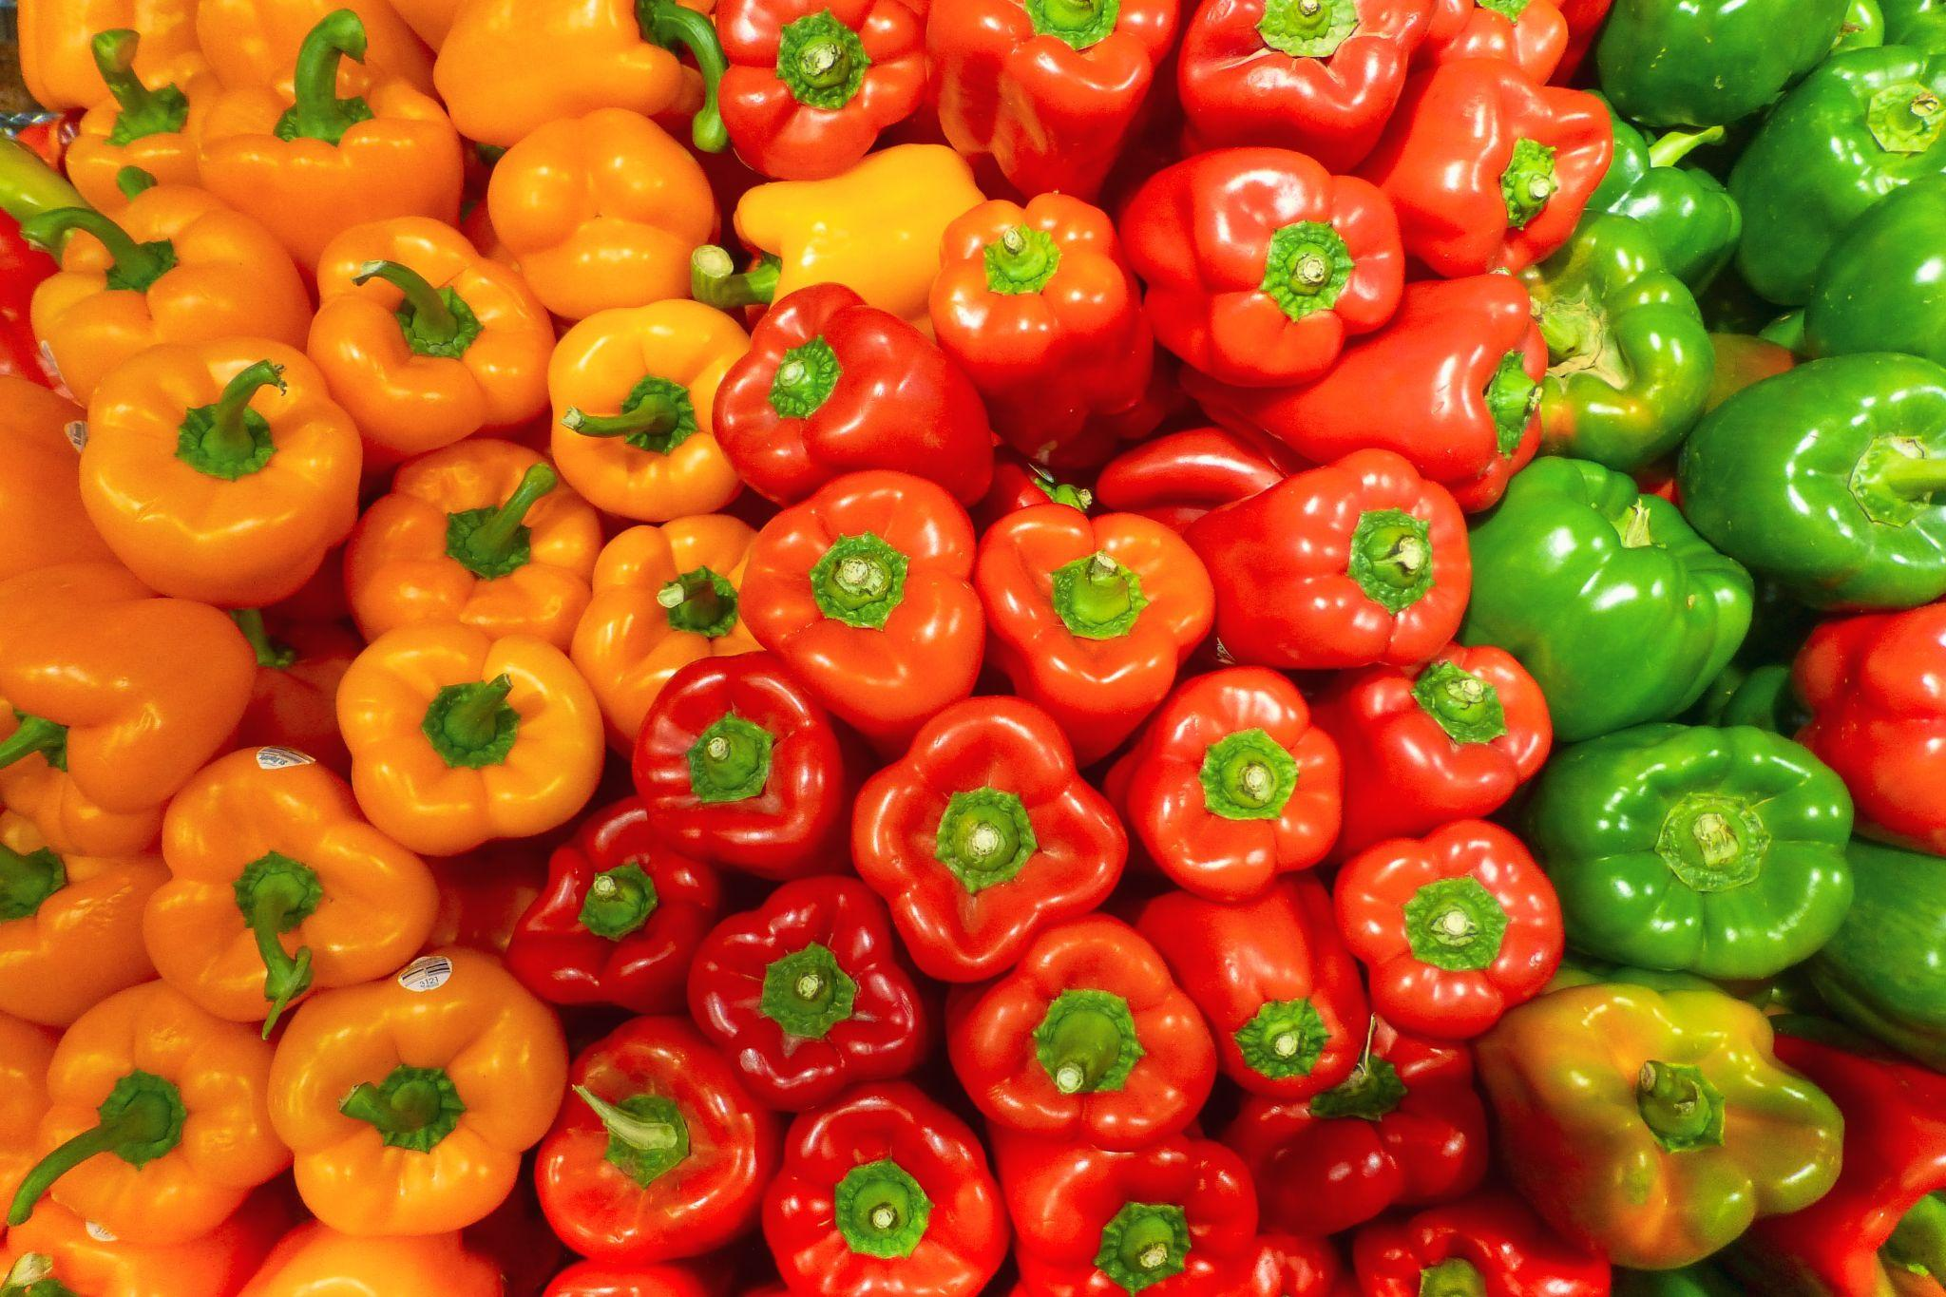

Stuck on what to cook?
Leave it to Dynamite Recipes! Your go to recipe generator. Select ingredients you have on hand and discover the recipes you could make!
Haven't been to the grocery store?
Don’t know what to throw together for a delicious meal?
What will we do?!

Slide 3
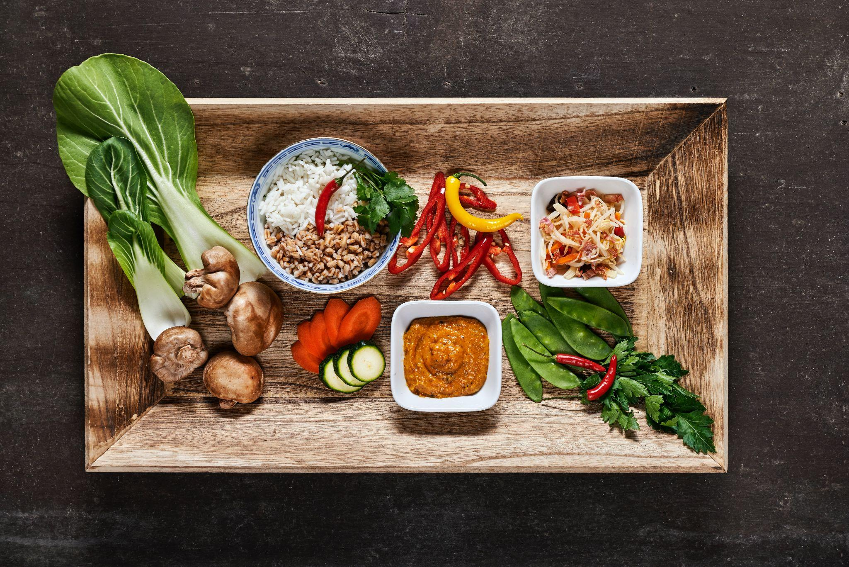
Description
Dynamite Recipes is an application that helps you find recipes using ingredients that you already have on hand. In the application you will be able to type in an ingredient and be met with a list of ingredients. After selecting your Ingredients, hit the generate recipe button and numerous recipes will be displayed for you to browse through.
Motivation
Several of our group members have used a similar app. We have found that those applications are not user friendly and believe our development is the Best.
We understand that people are are trying to stay home more due to covid. What if we could help by decreasing how many times you have to run out.

Slide 4

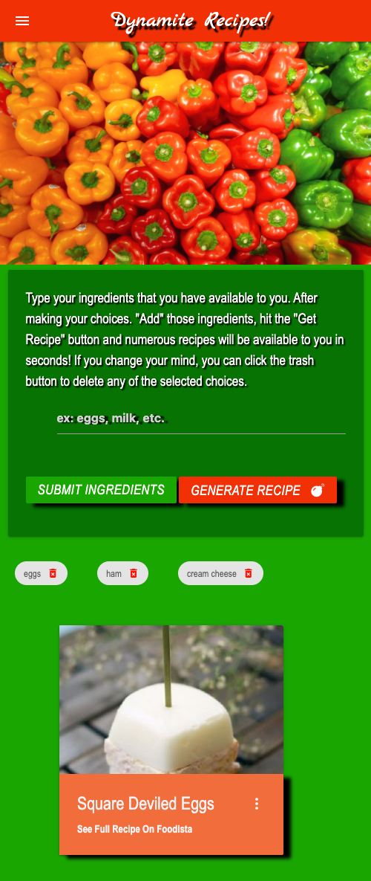
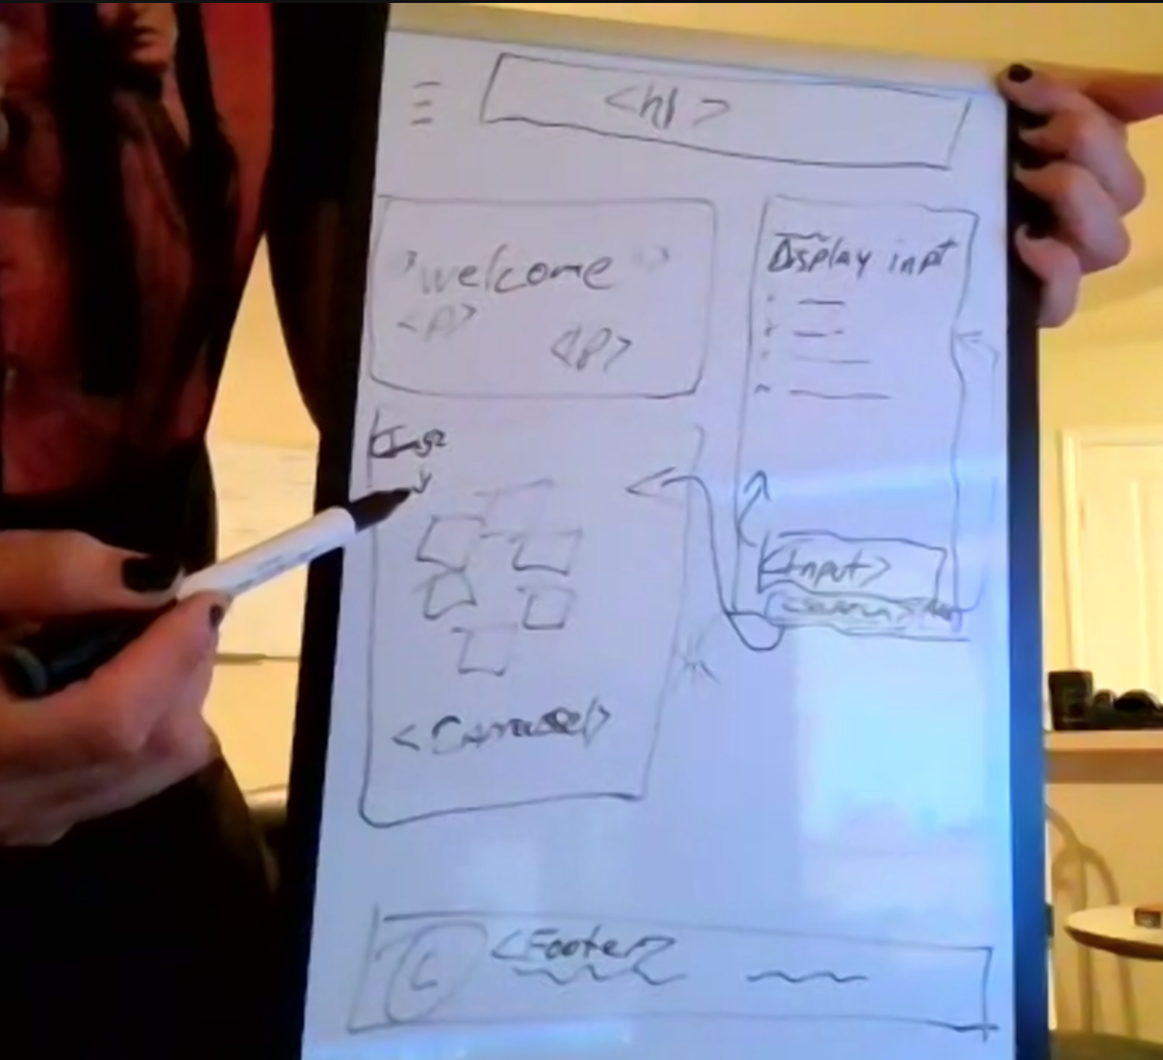
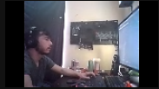
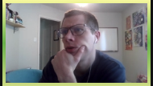
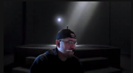
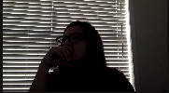
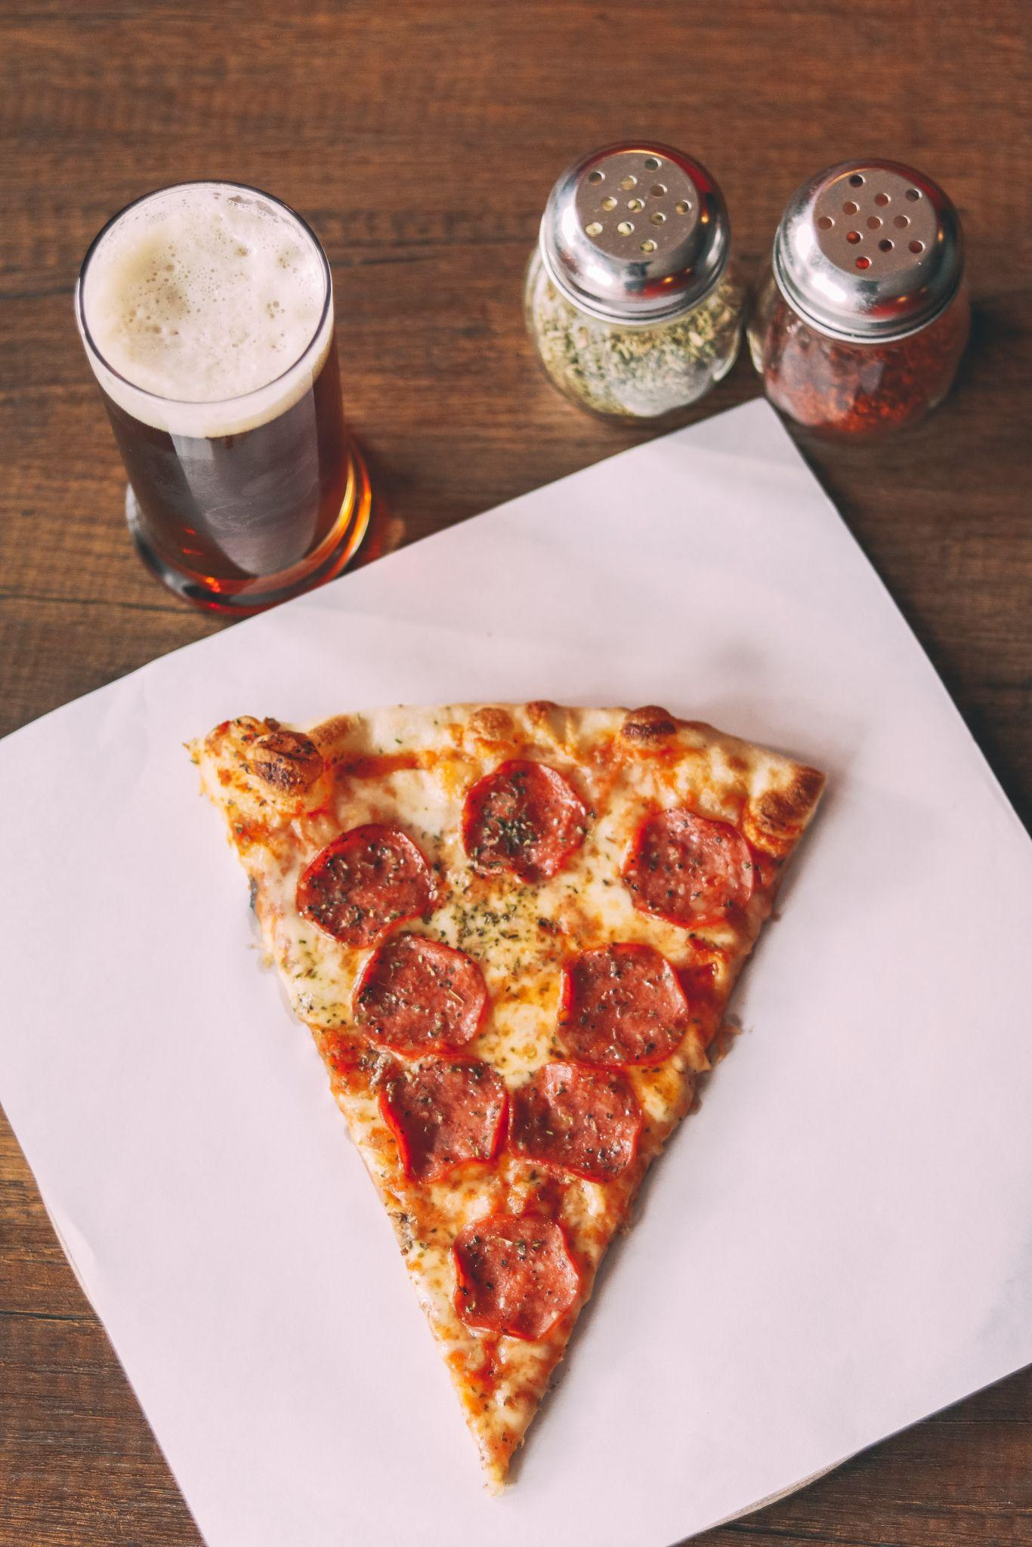

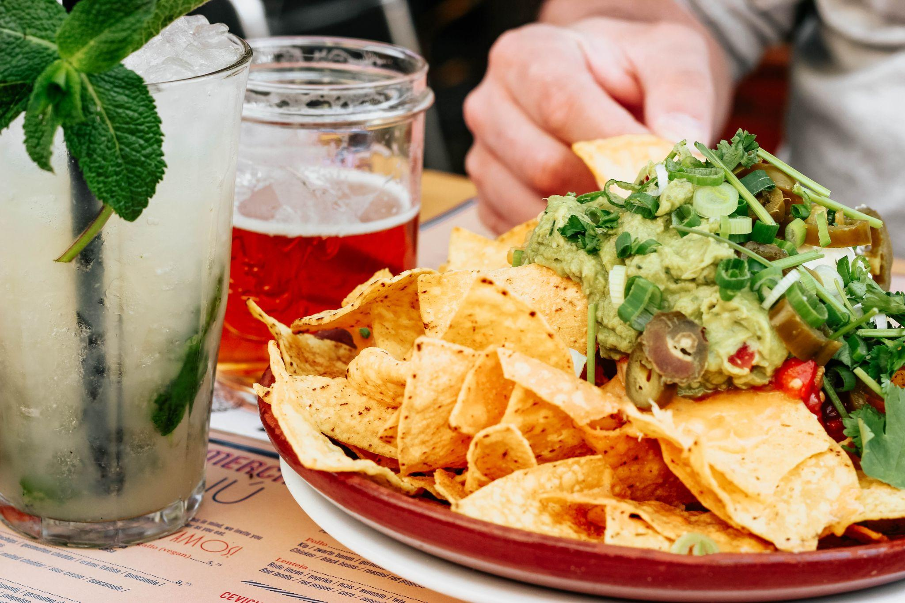


Google
Translate
spoonacular
Google
fonts
JavaScript
Materialize
CSS
HTML
Font
Awesome
JavaScript
CSS & HTML
API Research
ReadMe/ Slides
Damien
Vince
Chris
Chamo
Stephanie

Slide 5
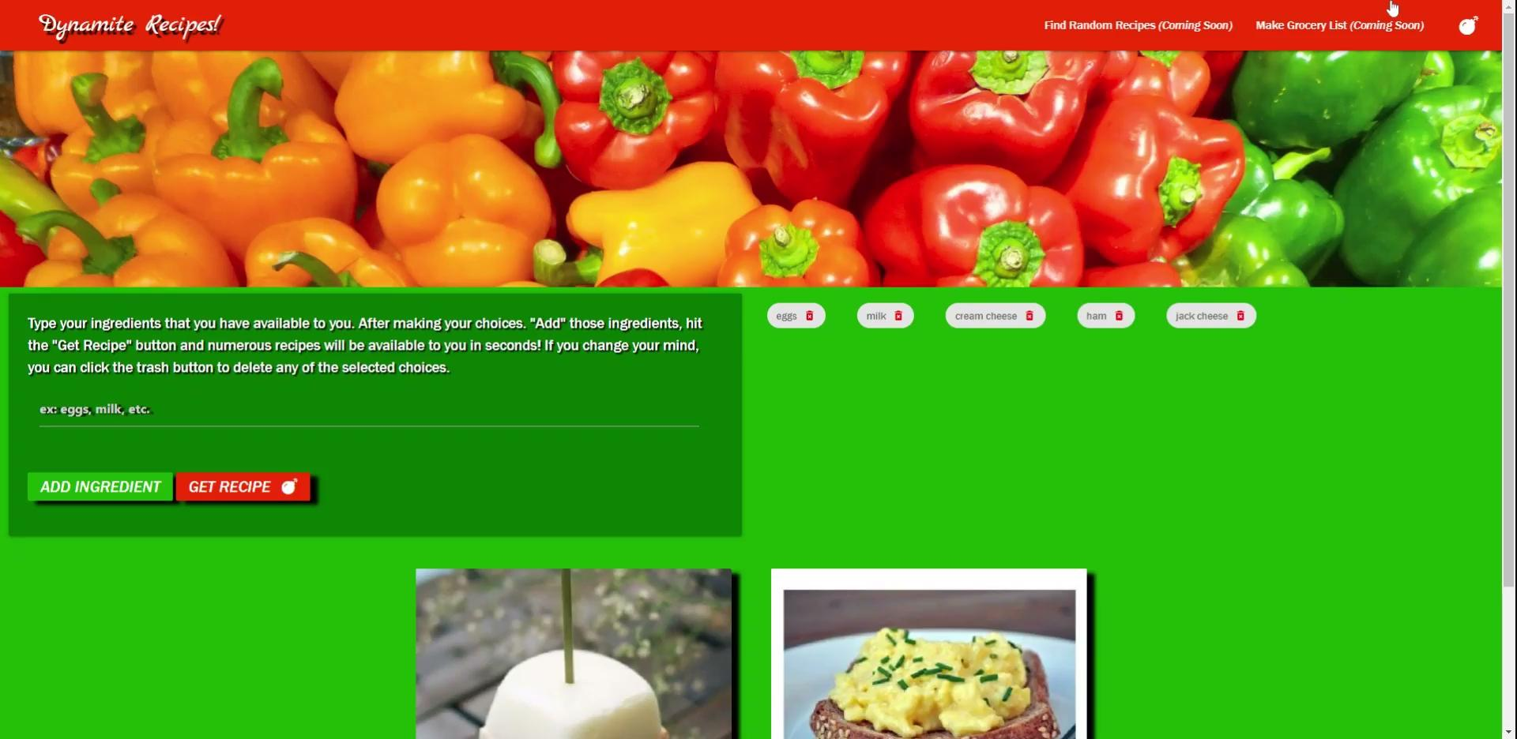
Dynamite Recipes! Demo

Slide 6
Directions for Future Development
We intend to activate a button to allow the user to generate random recipes in the near future.
The application specifically allows the user to see recipes that have zero missing ingredients. In the future we want to be able to let the user view recipes with one or two missing ingredients in case they are able to acquire them.
In the case the user is a few ingredients away from making a recipe or if they generated a random recipe, We want to allow the user to create a grocery list for said ingredients.

Slide 7

Vince
I struggled with managing interest and project deadlines.
I felt intimidated at first, thinking it was too much for me until I started to work on it and realize that I actually understood and knew what I was doing. Another challenge was learning my team-mates’ boundaries understanding that we all had different roles and try not to step into each other.
Chamo
Initially my confidence was at a all time low!
But the graciousness of my team, they lifted my confidence to an all time high! And that led to a great project outcome, that i am proud and grateful to be apart of!
Chris
I didn’t understand how API’s worked. Now I see their purpose and how to use them.
Successes and Challenges
Stephanie
I confronted an async javascript issue that nearly derailed the ENTIRE application. With the support of others, we were able to fix the problem. It really showed me what day to day coding will feel like in the professional world.
Damien

Slide 8
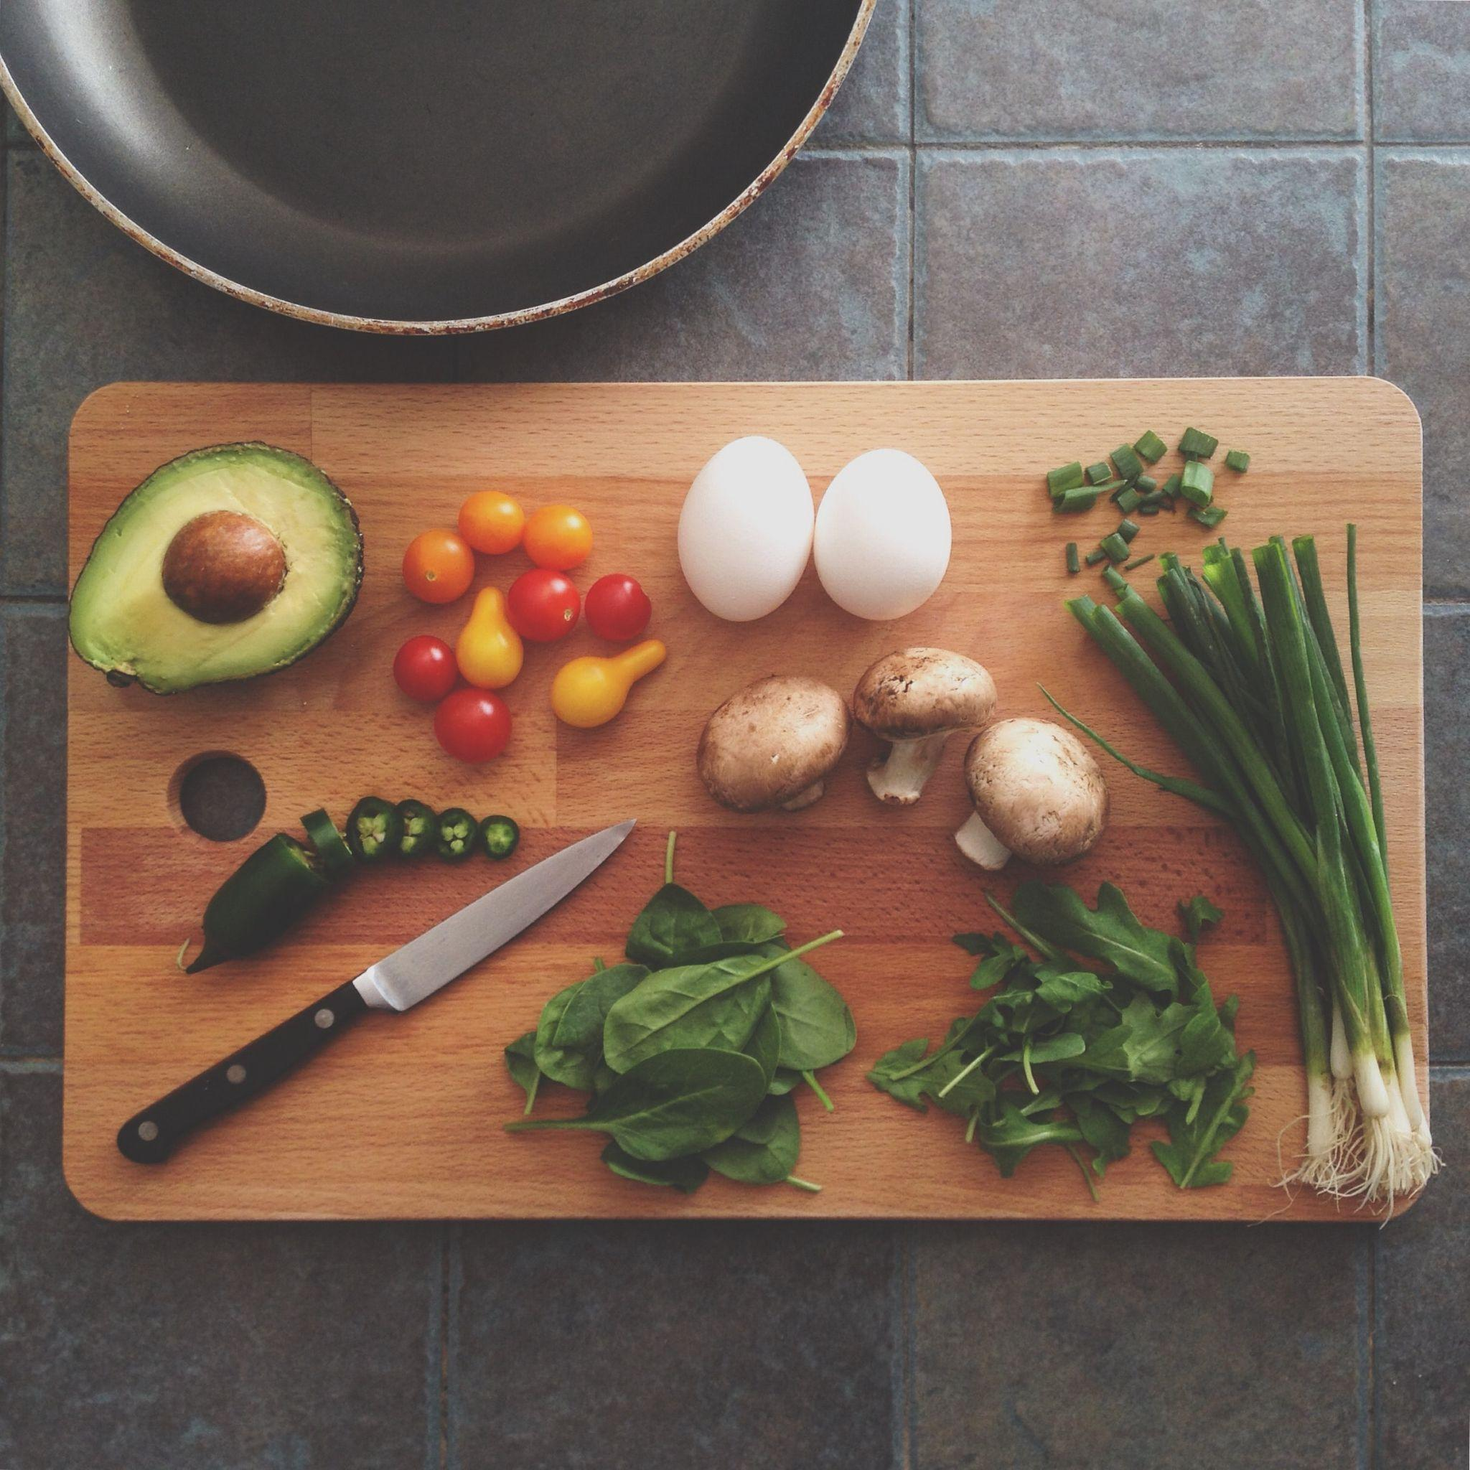
Deployed
URL
https://damienluzzo33.github.io/Project-1/
GitHub
Repo
https://github.com/damienluzzo33/Project-1.git

